Slide 1


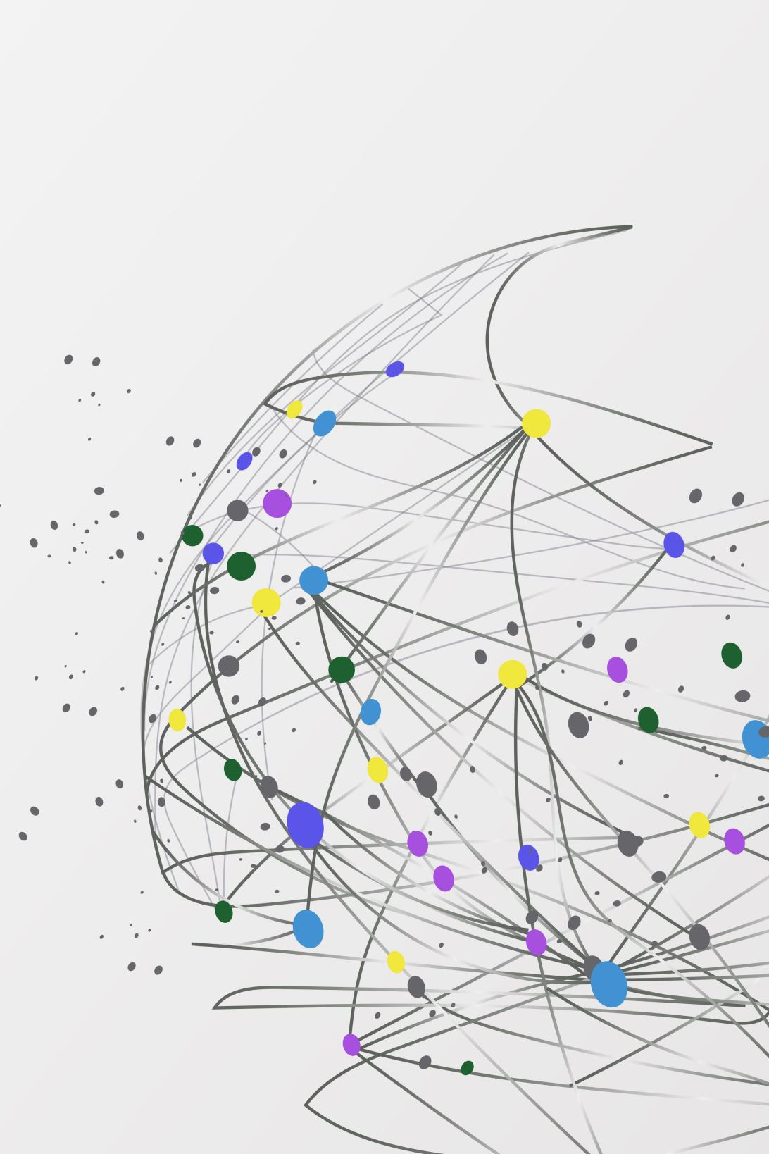
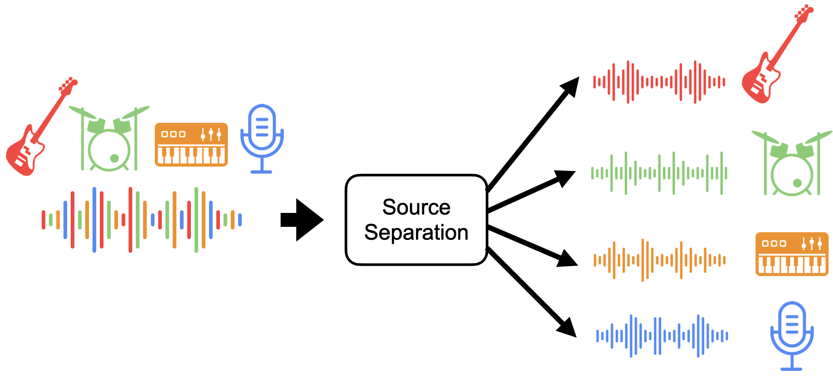
Audio Source Separation

Slide 2


Cocktail Party Problem
An old problem in signal processing and computational neuroscience, refers to how people or machines can distinguish and understand individual sounds or voices in a noisy, crowded setting that is similar to a busy cocktail party.

Slide 3
Applications of Source Separation
Music Production and Remixing
Noise Cancellation in Headphones
Voice Assistants

Slide 4

Music Separation
Separation of instrument tracks in music recordings, remixing, or enhancing audio quality.

Slide 5
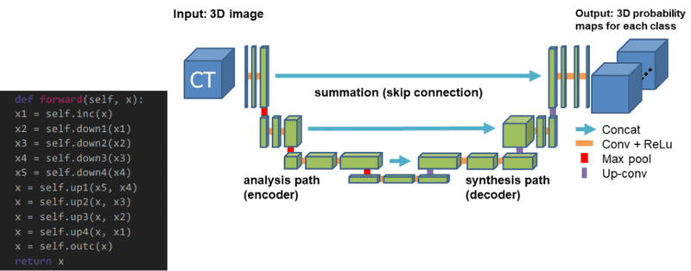
Most common model for music separation
U-Net: Neural network with encoding (contracting) and decoding (expanding) paths for precise image segmentation.

Slide 6

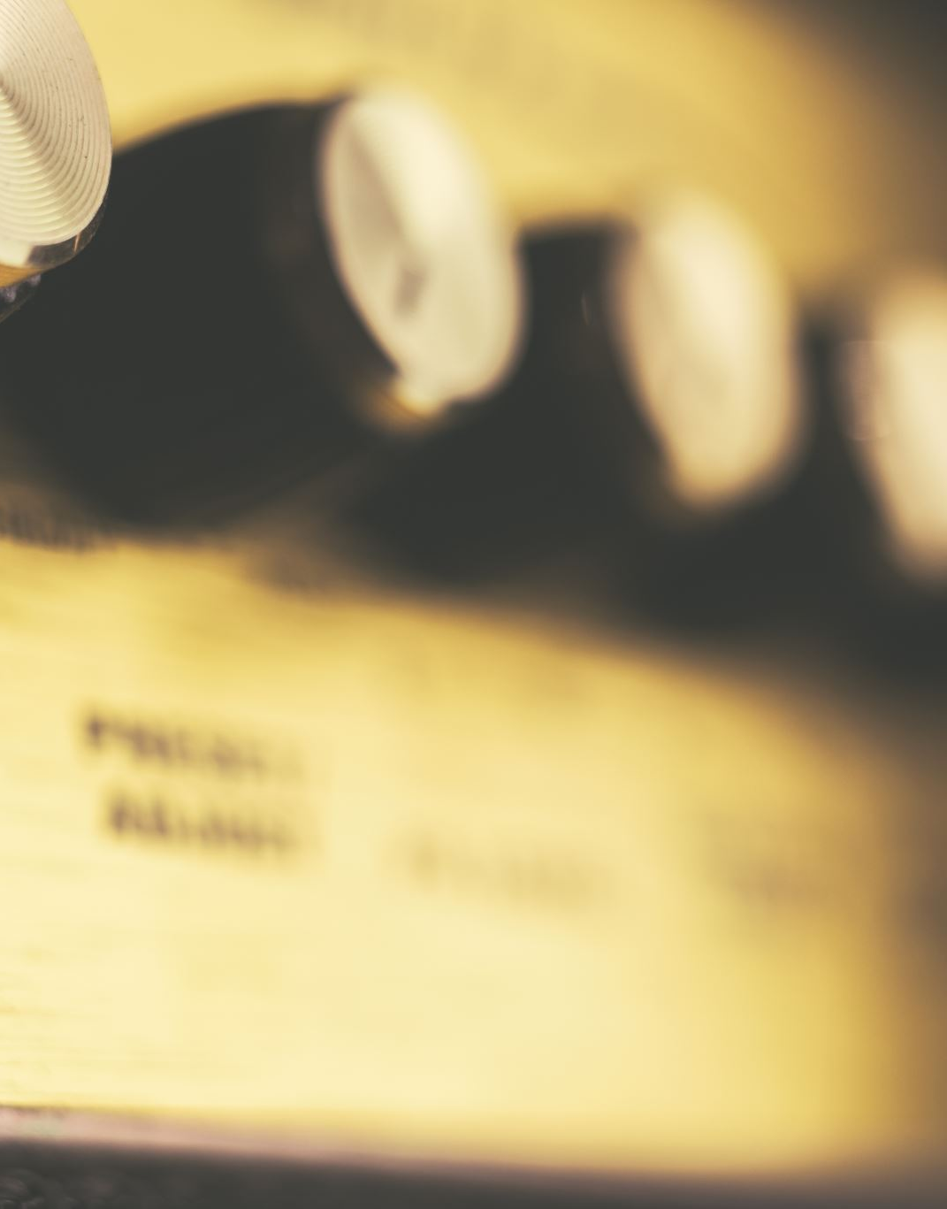
Algorithms that use U-net
Demucs (Deep Extractor for Music Sources)
Spleeter
Open-Unmix

Slide 7
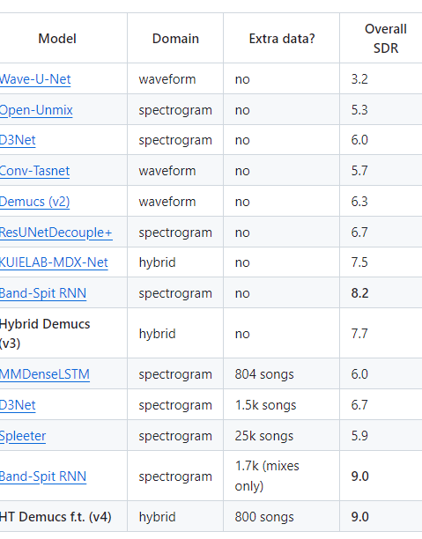
Quality Comparison

Slide 8
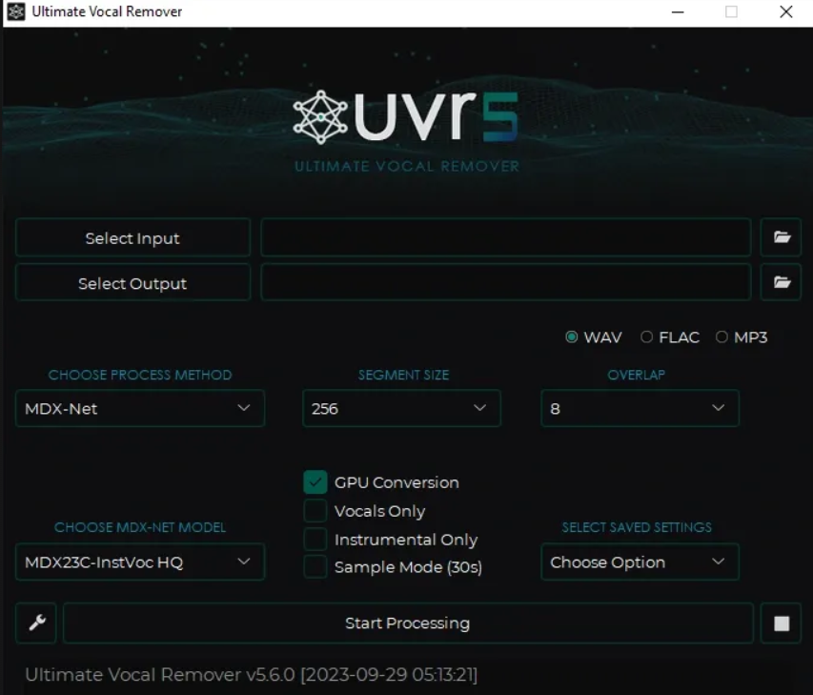
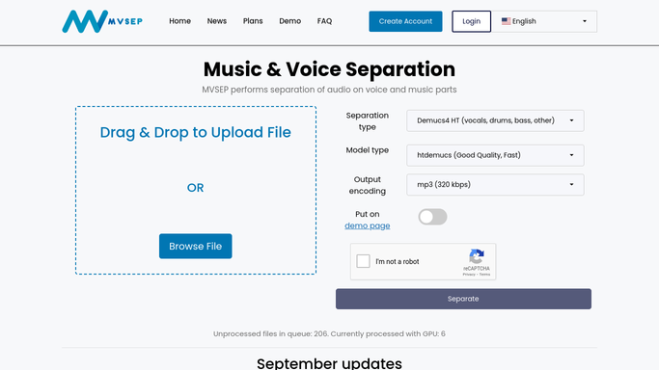
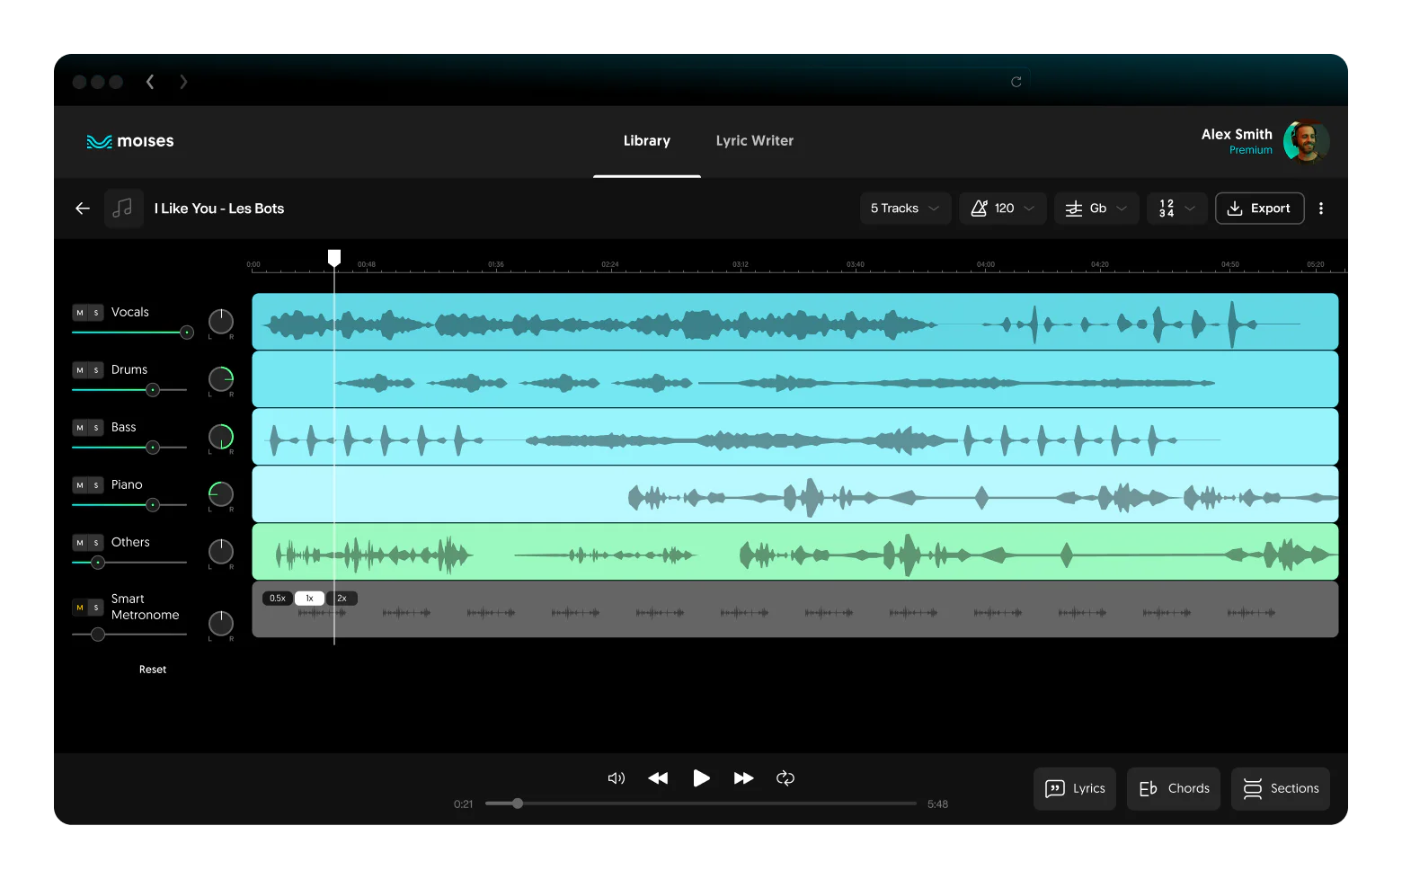
Software Examples
UVR (Ultimate Vocal Remover)
MVSEP
Moises

Slide 9

Noise cancellation
involves isolating and removing unwanted noise from a mixed audio signal by leveraging techniques of separating the noise source from the desired audio source.

Slide 10
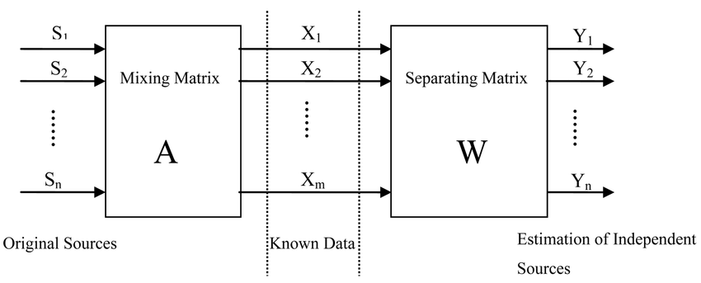
Blind Source Separation
Input: The mixed audio signals (X) are fed into the ICA algorithm.
Estimation: ICA estimates the unmixing matrix (A^(-1)) that, when multiplied by the mixed signals, separates them into independent sources (S).
Output: The output would ideally be individual tracks of each instrument playing, extracted from the mixed recording, allowing for separate analysis or processing.

Slide 11
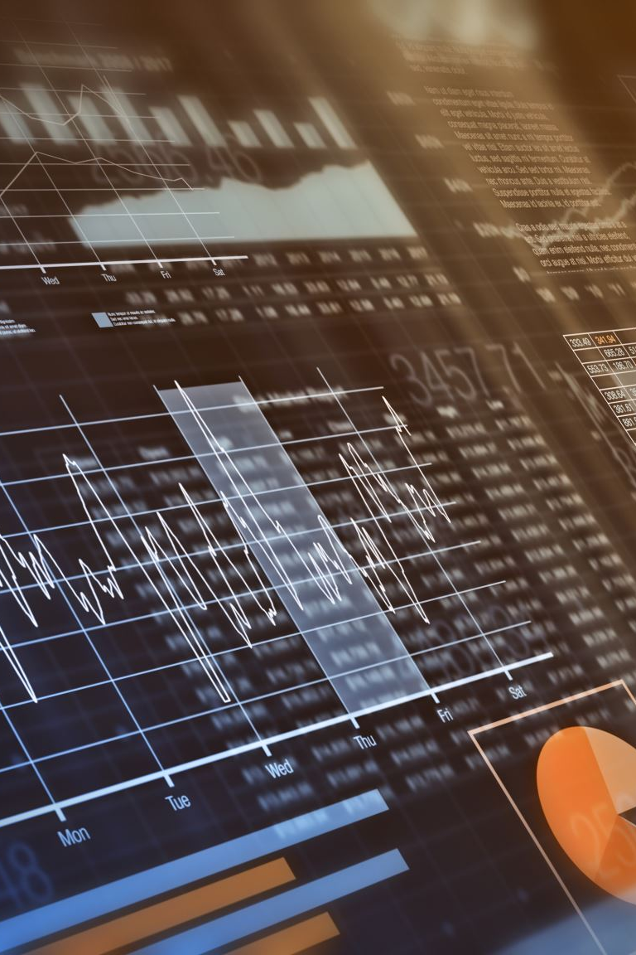
Though strong, ICA and related BSS algorithms may encounter difficulties in complicated or practical situations due to their reliance on specific assumptions regarding the statistical characteristics of the signals. In a variety of applications, they are useful tools for breaking down mixed signals into their component sources, though.

Slide 12
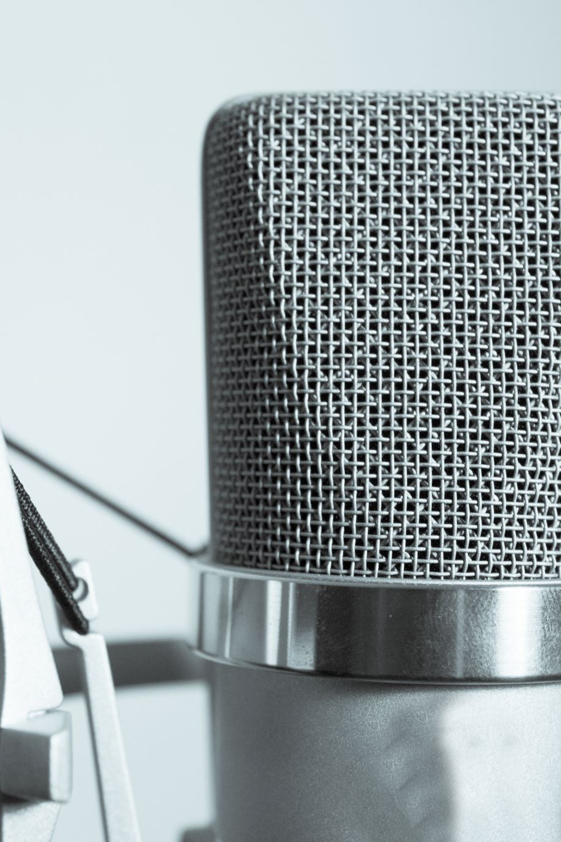
Noise Cancellation Examples
Cellphones
Voice assistant
Discord

Slide 13

Voice Assistants
Voice assistants rely on sophisticated signal processing and machine learning techniques, including aspects akin to voice separation, to accurately recognize and respond to user commands while navigating complex acoustic environments.
Challenges
Accurate Recognition
Robustness to Noise

Slide 14

Conclusion
All things considered, audio source separation is still being used in many different domains and industries, helping to improve communication, increase analysis, and produce higher-quality audio.

